Slide 1
Loading…
Click

Slide 2

Reading

Slide 3

Corporations

Slide 4

Corporations
ABC
BBC
Chicago Tribune
Guardian Datablog
Zeit Online

Slide 5

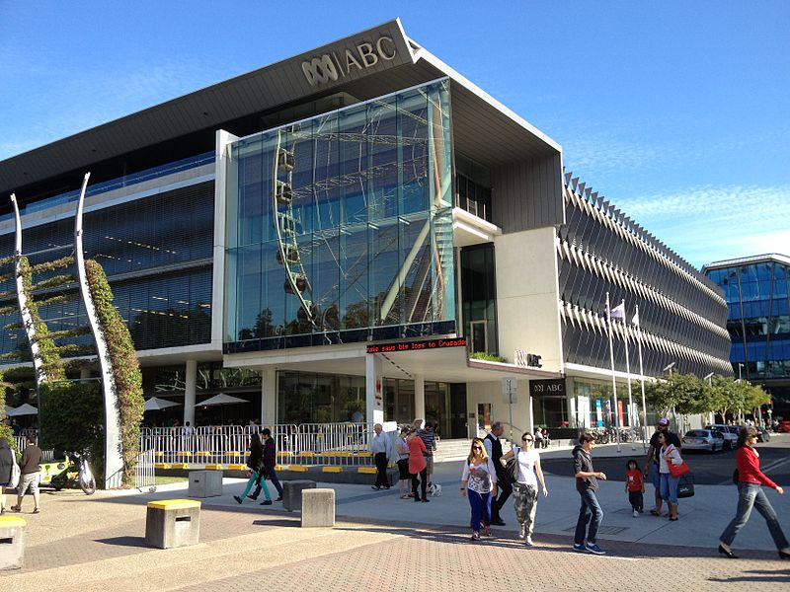

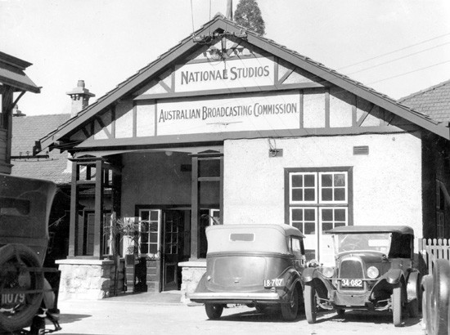
Australia’s national public broadcaster
Independent public service journalism

Slide 6

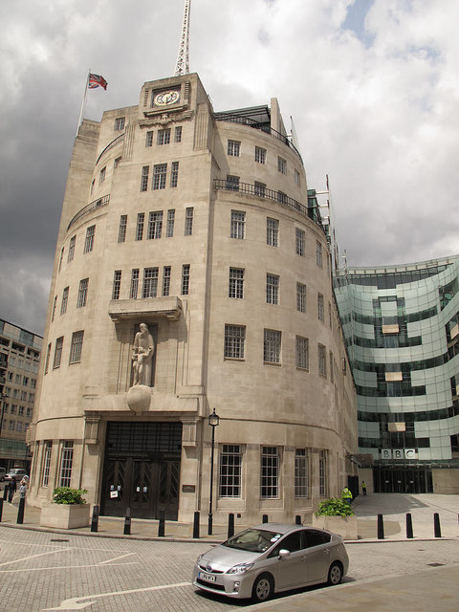


public-service broadcaster of the United Kingdom
Purpose of DJ
(From three perspectives)

Slide 7


Guardian
British national daily newspaper
Guardian Datablog

Slide 8
Name | Introduction | Culture
ABC | Australia’s national public broadcaster | Independent public service journalism
BBC | public-service broadcaster of the United Kingdom | produce TV and radio programmes for mass audiences
Chicago Tribune | a major daily newspaper based in Chicago, Illinois, United States | An American Paper for Americans
Guardian Datablog | British national daily newspaper | Guardian Datablog

Slide 9
Projects

Slide 10
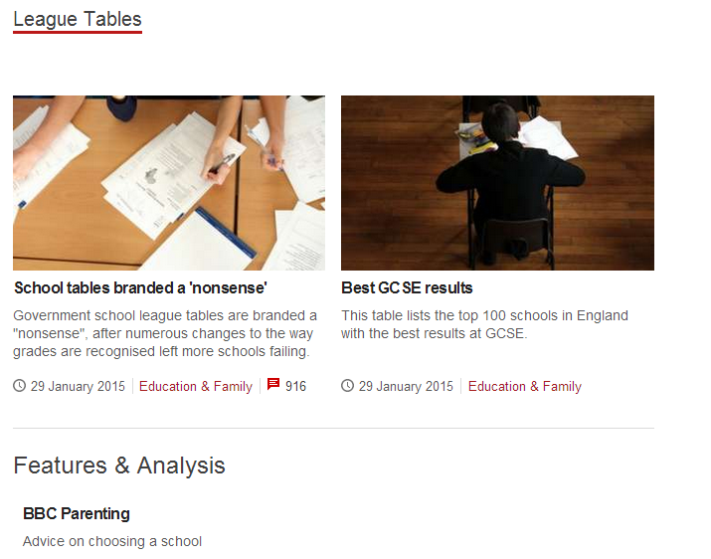
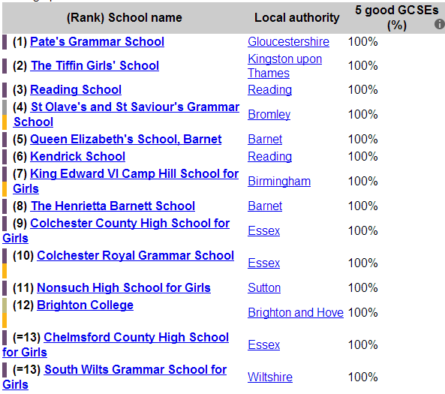
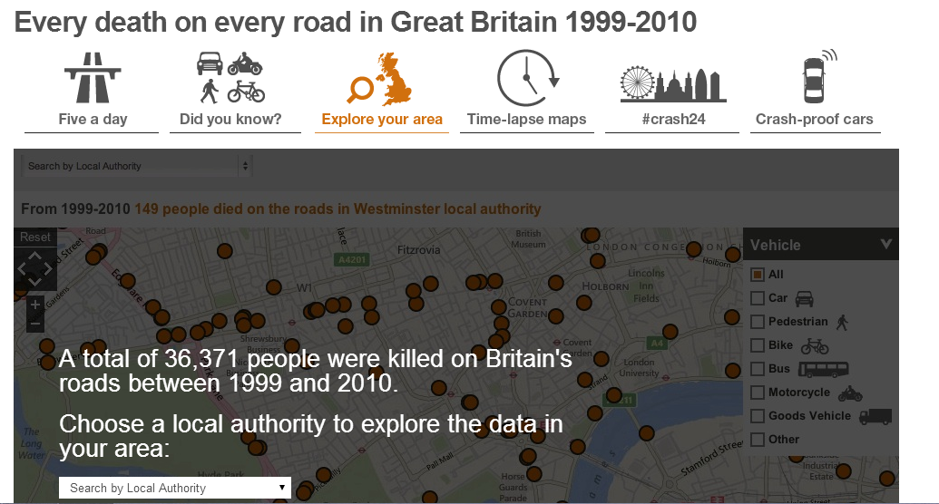
Name | Tips
School league tables | 1999
Every death on every road | find the location of all road fatalities
The world at 7 billion: What’s your number? | simple tools
BBC budget calculator | take effect or not
Public Sector pay: The numbers | sector analysis
Eurozone debt web | tangled web of intra-country lending

Slide 11
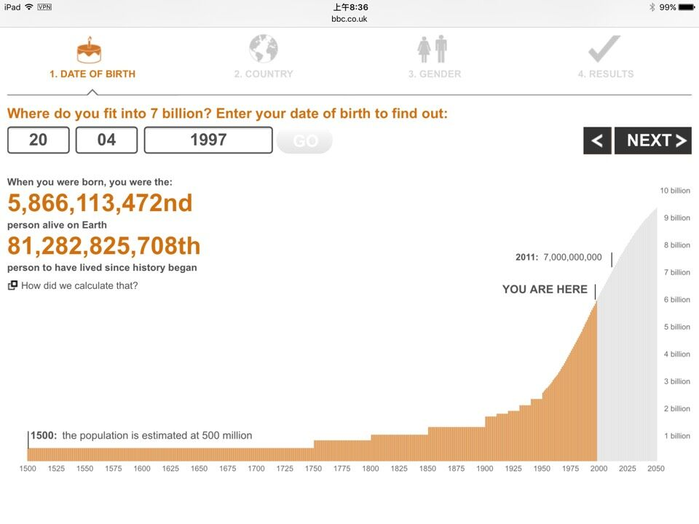
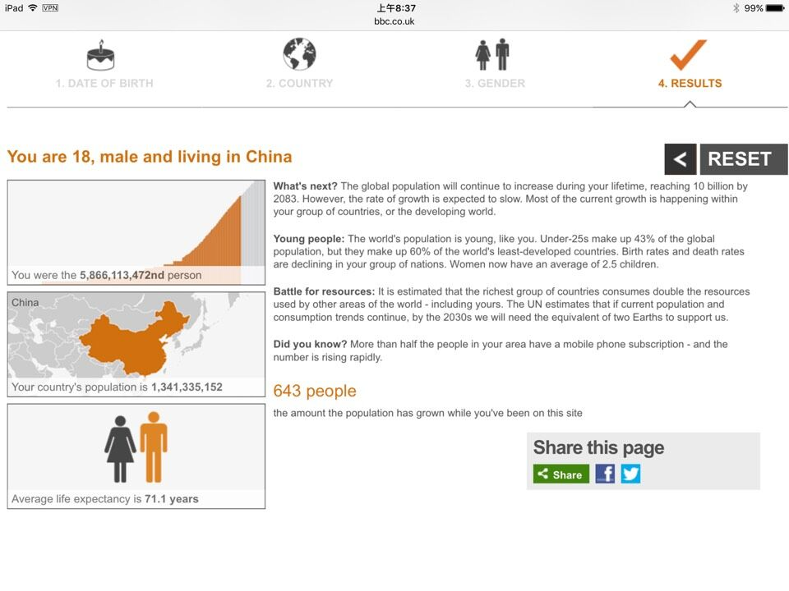
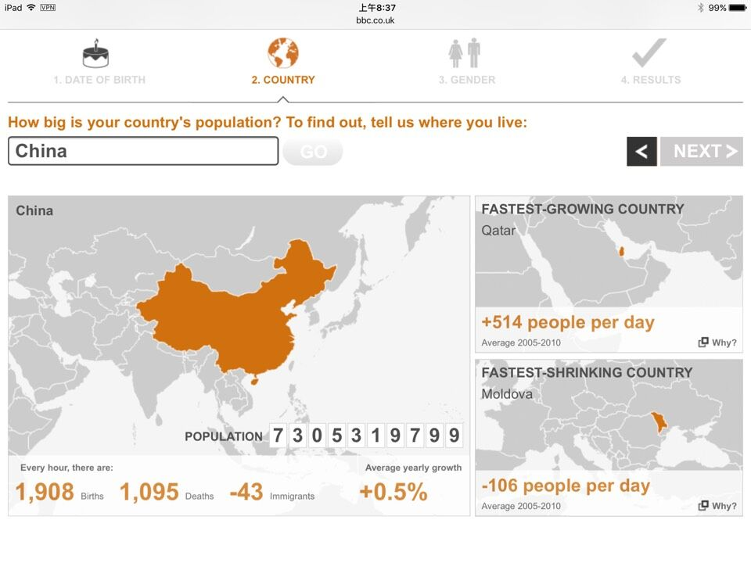
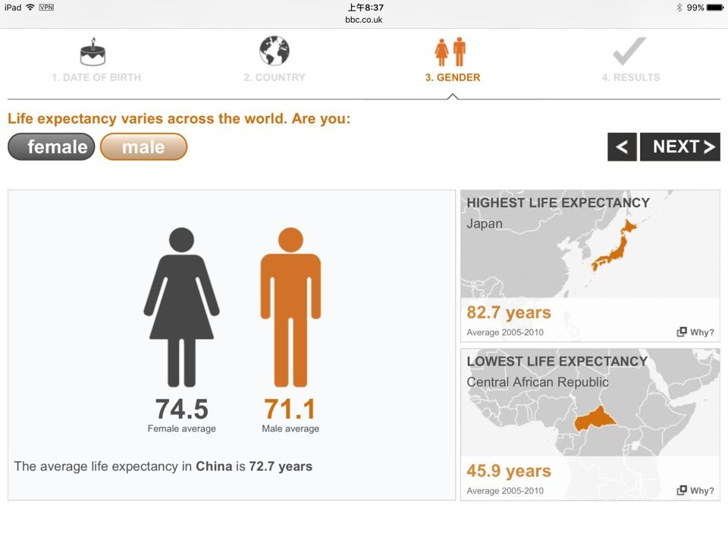
The world at seven billion
Where do you fit into 7 billion?
Country
Gender
Results

Slide 12
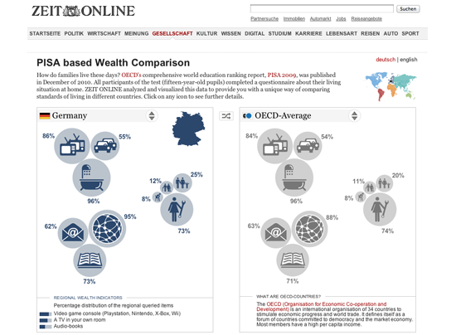
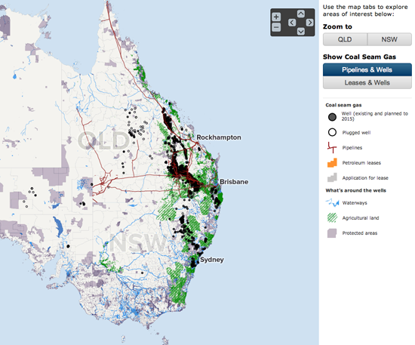
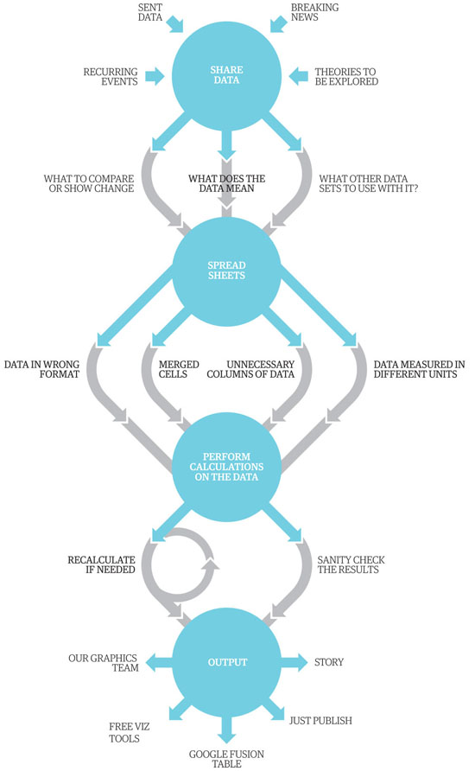

Others
Name | Corporation
‘Coal Seam Gas by the Numbers’. | ABC
Britain’s most unexpected piece of data journalism | GDBlog
WikiLeaks war logs | GDBlog
the release of the Treasury’s COINS database | GDBlog
The PISA based Wealth Comparison | Zeit
A map shows how many people would have to be evacuated in a similar situation in Germany. | Zeit

Slide 13
Key Words

Slide 14
Key Words
Data source
Cooperation
Techniques

Slide 15
Data source
ABC
BBC

Slide 16

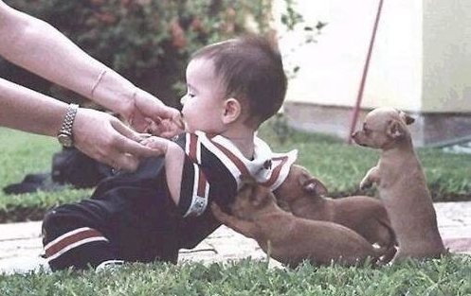
Cooperation
ABC
BBC
Chicago Tribune
Guardian Datablog
Zeit Online

Slide 17
Techniques
BBC

Slide 18
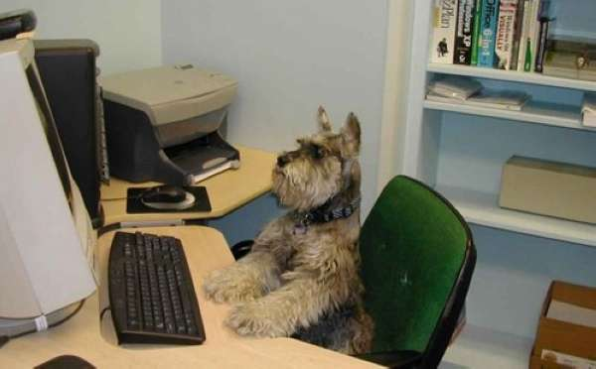


Techniques(19)
Excel, Google Docs and Fusion Tables
MySQL and Access databases and Solr
RDF and SPARQL
ActionScript, Python or Perl
Google and Bing Maps and Google Earth along with Esri’s ArcMAP
the Adobe Suite including After Effects, Illustrator, Photoshop and Flash

Slide 19
How To Hire a Hacker

Slide 20
Technology and IT department
Post on job website
Contact relevant mailing lists
Contact relevant organizations

Slide 21
Join relevant groups or networks
Harnessing External Expertise Through Hackthons
Local interest communities
Hackathon and competitions
Ask a geek

Slide 22
They code the full stack
They see the whole picture
They tell a good story
They talk things through
They teach themselves

Slide 23
Open government community
Code for America
https://www.codeforamerica.org/
Technical management

Slide 24
Harnessing External Expertise Through Hackathons

Slide 25
Find stories
Connect people
Host a social event

Slide 26
Following the Money: Cross-Border Collaboration
www.reportingproject.net/peopleofinterest/

Slide 27
Think outside your country
Make use of the existing investigative journalism networks
Make use of technology and collaborate with Hackers
www.investigativedashboard.org

Slide 28
Our Stories Come As Code
https://opendatacity.de/
https://apps.opendatacity.de/gema-vs-youtube/en/

Slide 29
Data projects don’t date
You can build on your past work
Data journalism pays for itself

Slide 30
Kass & Mulvad: Semi-finished Content for Stakeholder Groups

Slide 31
http://ekstrabladet.dk/kup/fodevarer/
http://xpoint.experian.dk/navnekort/
Thomas Müller
Mesut Özil
Angela Dorothea Merkel

Slide 32
Bussiness Models for Data Journalism

Slide 33
Data collection
Data analytics
Data visualization

Slide 34


